Slide 1
Health, Safety, and Accessibility Committee
2017 Bond-HSA Update
February 15, 2018

Slide 2
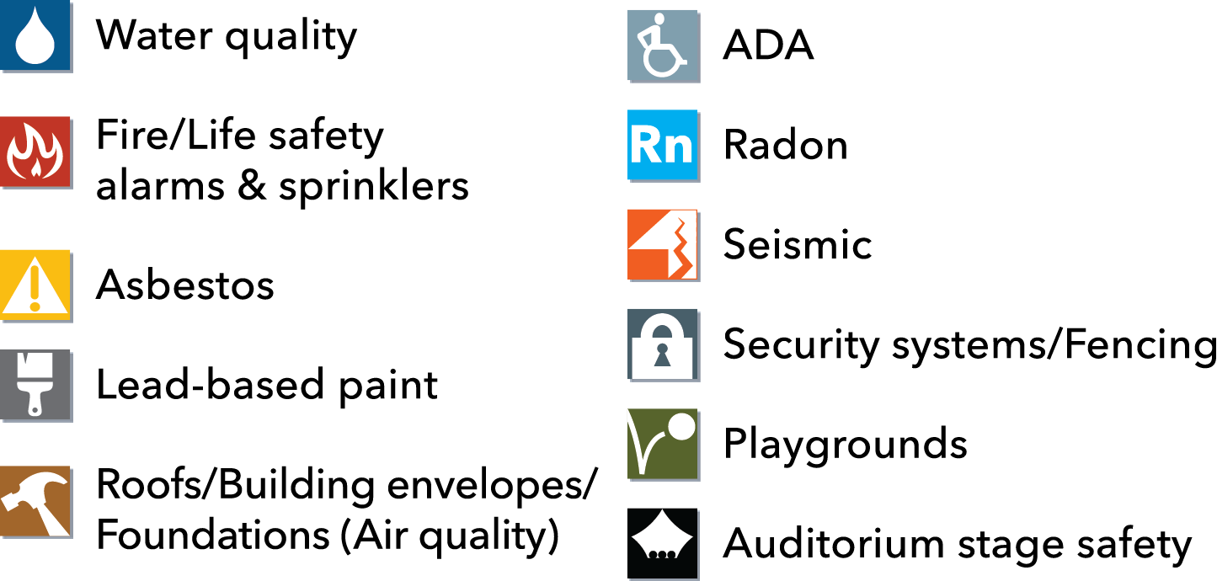
2017 Bond Health & Safety Categories:

Slide 3
Drinking Water Key Milestones:
Complete:
September, 2017 – Kick-off of Pilot Project Fixture Replacement at Astor
December, 2017 – Pilot Project Fixture Replacement Completed
All 15 schools returned to service*
December, 2017 – Group 2 awarded
January, 2018 – Group 3 awarded
February, 2018 – Group 4 bids opened; award pending
February 14, 2018 – Group 5 Bid Documents released to the four participating contractors
Bids scheduled to be opened on March 1, 2018
* 1 fixture at each of two schools remain under review and out of service and 1 kitchen fixture at another school remains in use under the pre-existing flush protocol
Notes:
Just the key dates, all on one slide. Consider breaking into two, highlighting what is complete with the table on the next slide.

Slide 4
Drinking Water Key Milestones:
Look Ahead:
February, 2018 - Group 3 initial fixture replacement completion expected
February 21 & 22, 2018 – Group 4 Mandatory “Pre-Bid” Site Visits
March, 2018 – Group 4 contracts awarded; fixture replacement completion expected in Spring, 2018
March, 2018 – Group 5 contracts awarded; fixture replacement completion expected in Spring/ Summer, 2018
April, 2018 – Group 6 contracts awarded; fixture replacement completion expected in Summer, 2018
Notes:
Just the key dates, all on one slide. May consider combining with the “Completed” Milestones, but that might make the table out of place.

Slide 7
Pilot Project Lessons Learned
Head Start programs require in classroom water for meals
K-2 have concerns about students needing to leave the classroom to access a hallway fountain
Communication, particularly with the school Principals, is critical
The Pilot Project Group 1 Principals have been extremely patient and helpful. Thank you Principals!
Building a partnership that begins with a handshake helps
Signing is needed to inform the users which fixtures may, or may not be used for drinking

Slide 8
Pilot Project Lessons Learned – Actions Taken
A communication plan has been implemented
Signs have been installed at 12 of the 15 Pilot Schools, with remaining 3 scheduled for completion this week
Rooms
Fixtures
11 of 15 Principals in Group 2 have been visited, the rest will be prior to Fixture Replacement
Every Principal in the remaining Groups will be involved early

Slide 9
Fixture Replacement Comprehensive List Group 1 (Pilot Program)
Group | School | Level | Cluster | Title 1
G1 | Applegate | Headstart | Jefferson
G1 | Astor | K-8 | Roosevelt
G1 | Atkinson | K-5 | Franklin
G1 | Beverly Cleary/Fernwood | 2, 4-8 | Grant
G1 | Chapman | 1-5 | Lincoln
G1 | Chief Joseph | K-5 | Jefferson
G1 | Hayhurst | K-5 | Wilson
G1 | Lewis | K-5 | Cleveland
G1 | Meek Professsional Technical | High School (10-12) | Jefferson
G1 | Richmond | K-5 | Franklin
G1 | Rose City Park | 1,3 | Madison
G1 | Sacajawea | Headstart | Madison
G1 | Skyline | K-8 | Lincoln
G1 | West Sylvan | Middle School | Lincoln
G1 | Woodstock | K-5 | Cleveland
“Pilot Project”
Fixture Replacement Complete
Notes:
Another way to show what has been completed

Slide 10
Fixture Replacement Group 2
Fixture Replacement Group 3
Group | School | Level | Cluster | Title 1
G2 | Beach | K-5 | Jefferson
G2 | Boise-Eliot | K-8 | Jefferson | Yes
G2 | Chavez | K-8 | Roosevelt | Yes
G2 | Clarendon | Headstart | Roosevelt
G2 | Creston | K-8 | Franklin
G2 | George | Middle School | Roosevelt | Yes
G2 | James John | K-5 | Roosevelt | Yes
G2 | Jefferson | High School | Jefferson
G2 | King | K-8 | Jefferson | Yes
G2 | Ockley Green | Middle School | Jefferson
G2 | Peninsula | K-5 | Jefferson | Yes
G2 | Rosa Parks | K-5 | Roosevelt | Yes
G2 | Sitton | K-5 | Roosevelt | Yes
G2 | Vernon | K-8 | Jefferson
G2 | Woodlawn | K-5 | Jefferson | Yes
Group | School | Level | Cluster | Title 1
G3 | Arleta | K-8 | Franklin
G3 | Benson | High School | Cleveland
G3 | Creative Science | K-8 | Madison
G3 | Harrison Park | K-8 | Madison | Yes
G3 | Holladay Center | Pioneer K-6 | Franklin
G3 | Kelly | K-5 | Franklin | Yes
G3 | Lane | Middle School | Franklin | Yes
G3 | Lent | K-8 | Franklin | Yes
G3 | Marysville | K-8 | Franklin | Yes
G3 | Rigler | K-5 | Madison | Yes
G3 | Roseway Heights | K-8 | Madison
G3 | Sunnyside | K-8 | Franklin
G3 | Tubman | Vacant | Jefferson
G3 | Whitman | K-5 | Cleveland | Yes
G3 | Woodmere | K-5 | Franklin | Yes
Fixture Replacement Completion Expected Winter, 2018 (In Progress!)
Fixture Replacement Completion Expected Winter, 2018 (In Progress!)
Notes:
Another way to show the forecast by group. Clearly, the note does not need to be blue or diagonally across the sheet…

Slide 11
Fixture Replacement Group 4
Fixture Replacement Group 5
Group | School | Level | Cluster | Title 1
G4 | Alameda | K-5 | Grant
G4 | Beaumont | Middle School | Grant
G4 | Bridger | K-8 | Franklin | Yes
G4 | Cleveland | High School | Cleveland
G4 | Glencoe | K-5 | Franklin
G4 | Hollyrood | K | Grant
G4 | Irvington | K-8 | Grant
G4 | Laurelhurst | K-8 | Grant
G4 | Lee | K-8 | Madison | Yes
G4 | Madison | High School | Madison
G4 | Mt Tabor | Middle School | Franklin
G4 | Sabin | K-8 | Grant
G4 | Scott | K-8 | Madison | Yes
G4 | Vestal | K-8 | Madison | Yes
G4 | Youngson | Pioneer | Franklin
Group | School | Level | Cluster | Title 1
G5 | Abernathy | K-5 | Cleveland
G5 | Buckman | K-5 | Cleveland
G5 | Capitol Hill | K-5 | Wilson
G5 | Duniway | K-5 | Cleveland
G5 | Grout | K-5 | Cleveland | Yes
G5 | Hosford | Middle School | Cleveland
G5 | Jackson | Middle School | Wilson
G5 | Lincoln | High School | Lincoln
G5 | Llewellyn | K-5 | Cleveland
G5 | Markham | K-5 | Wilson | Yes
G5 | Monroe/Da Vinci | Middle School | Cleveland
G5 | Sellwood | Middle School | Cleveland
G5 | Stephenson | K-5 | Wilson
G5 | Wilson | High School | Wilson
G5 | Winterhaven | K-8 | Cleveland
Bids opened on Feb 8!
Fixture Replacement Completion Expected Spring, 2018
Bid Walks planned for Feb 21 & 22!
Fixture Replacement Completion Expected Spring/ Summer 2018

Slide 12
Fixture Replacement Group 6
Fixture Replacement Group 7
(Administration Buildings / Vacant)
Group | School | Level | Cluster | Title 1
G6 | Ainsworth | K-5 | Lincoln
G6 | Bridlemile | K-5 | Lincoln
G6 | East Sylvan | K-8 | Lincoln
G6 | Forest Park | K-5 | Lincoln
G6 | Grant @ Marshall | High School | Madison
G6 | Gray | Middle School | Wilson
G6 | Maplewood | K-5 | Wilson
G6 | MLC | K-12 | Lincoln
G6 | Rieke | K-5 | Wilson
G6 | Columbia | Leased School | Jefferson
G6 | Edwards | Family Services | Cleveland
G6 | Green Thumb | Transitional | Franklin
G6 | Humboldt | Leased School | Jefferson
G6 | Kenton | Leased School | Jefferson
G6 | Terwilliger | Leased School | Wilson
Group | School | Level | Cluster | Title 1
G7 | Holladay Annex | Administration | Franklin
G7 | BESC | Administration
G7 | Rice | Administration
G7 | Wilcox | Administration
G7 | Smith | Vacant
G7 | Washington/ DEQ (Auto Shop) | Vacant
To be considered after all the students have been served.
Fixture Replacement Completion Expected Summer, 2018

Slide 14
CH2M Hill Lead Mitigation Contract
Reviewing contract and amendments
Status of each task
Deliverables remaining
Reviewing billing and budget
Elevated lead decision making
Seamless transition from Bond to Maintenance Department

Slide 15
Water Quality – Fixture Replacement:
Senate Bill 1062 Stakeholder Advisory Group is working with the Oregon Department of Education and the Oregon Health Authority as they develop OARs by 1/1/2019
Initial indications are leaning towards a rule requiring water testing for lead every 6-year years
Meetings to date on 11/2/17 and 1/29/18
Notes:
Senate Bill 1062 = Healthy and Safe Schools Act
OARs = Oregon Administrative Rules
PPS Directors of Risk Management and Government Relations are participating in the Senate Bill 1062 Stakeholder Advisory group

Slide 16
Fire Alarm Systems:
2016 Inter-Governmental Agreement (IGA) between PPS and City of Portland Fire and Rescue
Agreement: this document defines the process and schedule for PPS to upgrade fire alarm systems in accordance with fire code requirements
Ongoing Work: PPS has ongoing work at multiple sites that are upgrading fire control panels and fire detection/annunciation devices based on this IGA’s requirements
Groups and Phasing: the District is broken into 2 groups to ensure that the oldest fire systems are addressed first; fire alarm system upgrades are broken into two phases for the purpose of scheduling the necessary permitting and construction work
Bond Resources: PPS is in discussions with City of Portland about options for combining the performance of work by PPS fire alarm staff with outside contractors to take advantage of bond resources in the most effective way possible

Slide 17
Fire Sprinkler Systems:
Fire Sprinkler System Upgrades
Prioritization Criteria:
Sprinkler Coverage: buildings with less fire sprinkler coverage, increasing the potential spread of fire and smoke, are prioritized
Type of Construction: buildings constructed primarily of wood, increasing the potential spread of fire and smoke, are prioritized
Occupants: buildings with K-2 classrooms, limiting the ability to safely exit building during a fire due to the age of occupants, are prioritized
Exiting: buildings with multiple stories, limiting the ability to safely exit building during a fire due to distance to nearest building exit, are prioritized
Ranking of Schools:
Ranking: each of the 4 criteria is assigned a score of 0 to 1 based on the associated risk, with each school ranked a total of 0 to 4, with the greatest ranking receiving the highest prioritization for fire sprinkler system upgrades

Slide 18
Fire Alarm Systems, Groups and Phasing:
Group 1
Phase 2: fire alarm control panel upgrades mostly complete, continuing with fire detection and annunciation upgrades
Abernethy*
Beach*
Beaumont
Bridger
Bridlemile
Chapman*
Chavez*
Creston
Duniway*
E Sylvan
Holladay Center
Hollyrood
Humboldt
Kelly
Laurelhurst*
Rice
Sacajawea
Scott
Sellwood*
Skyline
Terwilliger
Whitman
Wilcox
Woodmere
Woodstock
Youngson
Group 1
Phase 3: fire alarm control panel and fire detection/annunciation upgrades partly complete
Abernethy | Llewellyn
Alameda | Peninsula
Beach | Portsmouth/Chavez
Beaumont | Rieke
Bridger | Rose City
Bridlemile | Sacajawea
Buckman | Scott
Capitol Hill | Sellwood*
Chapman* | Sitton
Chief Joseph | Skyline
Clark | Terwilliger
Columbia Site | Whitman
Creston | Wilcox
Duniway | Woodmere
E Sylvan | Woodstock
Edwards | Youngson
George
Glencoe
Hayhurst
Holladay
Hollyrood
Humboldt
Kelly
Kelly Center (Annex)
Laurelhurst
Lewis
Group 1
Complete
Creston Annex
Rice
Group 2
In Planning
Ainsworth Annex
Applegate
Astor
Atkinson
Forest Park
Green Thumb
KBPS
Kenton
King
Lent
Maplewood
Markham
Meek
Monroe / DaVinci
Richmond
Rigler
Sabin
Stephenson
Vernon

Slide 19
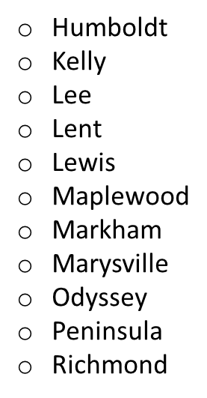
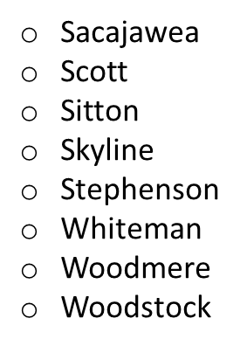
Fire Sprinkler Systems:
Starting Fall, 2017
Prioritization: prioritization of the schools with the highest ranking, between 3 and 4, on a scale of 0 to 4
Applegate
Astor
Atkinson
Bridger
Bridlemile
Capitol Hill
Chief Joseph
Clarendon
Creston
Harrison Park
Hayhurst
Packaging of Work: fire sprinkler upgrade work can be packaged with other H & S projects at specific school sites to limit impact of overall bond-related construction activities

Slide 20
Asbestos Abatement:
Asbestos is a mineral fiber that occurs in rock and soil
2,412 recorded applications in PPS
6 local abatement firms contracted
Proof of clearance during each abatement by an independent 3rd party
Asbestos abatement can occur all year long but does require empty building and/or off-hours with containment area

Slide 21
Asbestos Abatement:
Completed:
Pre-2017 bond, small-scale abatement projects and abatement as part of repairs or construction
Summer 2017 and weekends
Abatement of pipe insulation. Examples include Wilson Auditorium prop room, Buckman basement
Wrapping Up:
Asbestos Containing Material (ACM) tile flooring replacement at Stephenson, Sitton, and Beaumont cafeteria
Next:
Project Manager assigned, surveys have been completed of potential 2018 abatement sites
Notes:
Significant planning required for abatement projects of significant square footage such as flooring, ceilings, and spray-on fire proofing. Large scale asbestos abatement requires an unoccupied site for negative pressure containment and other controls.
ACM = Asbestos Containing Material

Slide 22
Asbestos Abatement:
2018 – time for the three year AHERA inspections (Asbestos Hazard Emergency Response Act)
Risk Management has five certified asbestos inspectors on staff and certified contractors available
Asbestos Management plan will be updated for each site
Updated inventory will reflect fewer applications of asbestos due to abatements and school modernizations
Notes:
AHERA = Asbestos Hazard Emergency Response Act
Asbestos Management plan per site is an AHERA requirement
PPS Risk Management uses the Verdant database product for asbestos management

Slide 23
Lead Paint:
Immediate and Intermediate
Surveys done Fall 2016 through Spring 2017
All interior and exterior surfaces at over 90 sites were assessed by PBS Environmental Detailed reports are on the Healthy and Safe Schools page https://www.pps.net/Page/4070
Over one million square feet of painted surfaces will be encapsulated
Spring/Summer 2017; Astor, Atkinson, Hayhurst and Woodstock exteriors were re-painted
Exterior
Spring/Summer 2017; Astor, Atkinson, Hayhurst and Woodstock exteriors were re-painted
Interior
Hired five new painters and one plasterer solely for Lead paint remediation
Twenty sites with most deteriorated paint were addressed this summer
Major portions of James John, Skyline and Sabin have been addressed
Exterior
Spring/Summer 2017; Astor, Atkinson, Hayhurst and Woodstock exteriors were re-painted
Intermediate and beyond
OSM led strategy to deliver an effective interior and exterior program
PPS Staff painters, plasterer and project management
Coordination with other PPS projects
Outside contractors with PPS Purchasing & Contracting support

Slide 24
Roofs/Building Envelopes/Foundations
21 Roofs replaced with 2012 Bond
3 with rebuild of schools
2017 Bond – First group of projects has been prioritized and will be communicated to school site administration

Slide 25
Roofs/Building Envelopes/Foundations
Maintenance and OSM working together
Some may need repairs now to get them through another season
Re-evaluating now – post rainy season
Adjustments will be necessary
Re-evaluation will happen on a periodic basis

Slide 26
ADA - Accessibility:
Internal stakeholder input received by Fall 2017
Four funding priority scenarios developed Fall 2017
Need stakeholder input to evaluate/recommend funding priority; early 2018
DRAFT presentation to the full Board of Education, Spring 2018

Slide 27
Facilities Condition Assessment (FCA):
Request For Proposal advertised February 7th, 2018
Pre-proposal meeting February 21st, 2018
Proposals due March 29th, 2018
Interviews April 20th, 2018
Notice of Intent to Award April 27th, 2018

Slide 28
Radon Mitigation Systems
Radon is a naturally occurring radioactive gas and long-term health hazard
Oregon Health Authority and the new Healthy and Safe Schools act require re-testing locations with mitigation systems every five years. Every ten years when no previous mitigation has been required
Radon mitigation systems in PPS are required to have a ten-year warranty

Slide 29
Radon Mitigation Systems
14 mitigation systems completed in 10 schools (nine awaiting final city inspection)
Beaumont
Kelly
Lane
Lent – two systems
Meek – two systems
Ockley Green – two systems
Peninsula
Roosevelt – two systems
Roseway Heights
Skyline

Slide 30
Radon Mitigation Systems
Three systems in development or performance validation stage
Astor, Humboldt, and Vernon
Two sites not started yet due to asbestos abatement in progress
Marysville and Wilcox
Notes:
Edwards site - in contracting
Initial re-testing required per protocol at Cesar Chavez due to elevator project. Earth moving work requires re-testing

Slide 31
Radon Mitigation Systems
Annual Radon plan will post on September 1, 2018
Risk Management working with CIPA to evolve the web presence of radon information
Healthy and Safe Schools web page updated with thorough detail https://www.pps.net/Page/4070.

Slide 32
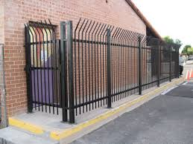
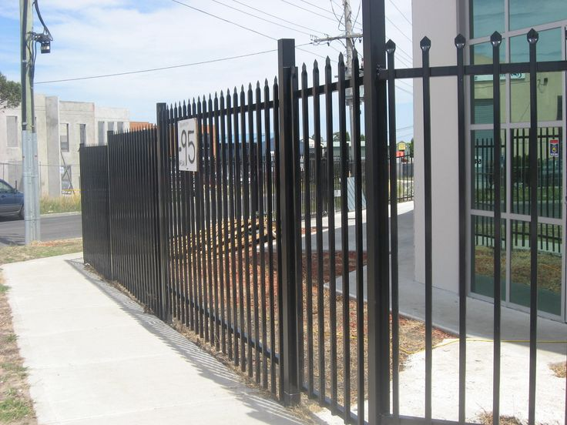
Security: Stakeholder Engagement with school site administration, staff and community members will begin soon!

